Slide 1
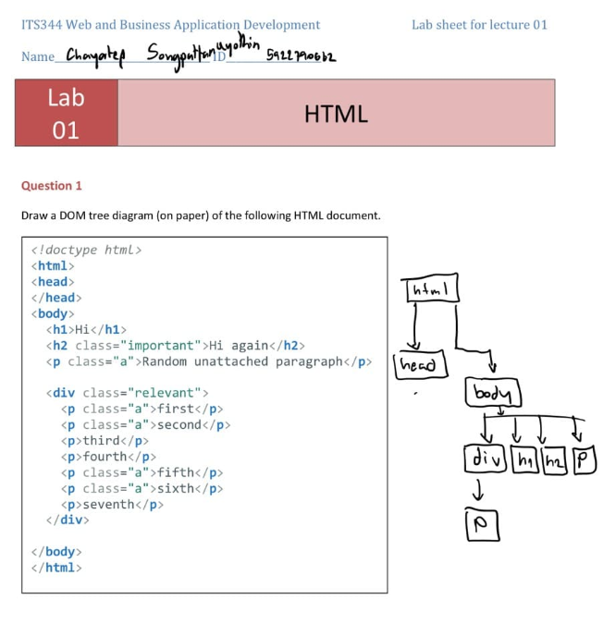
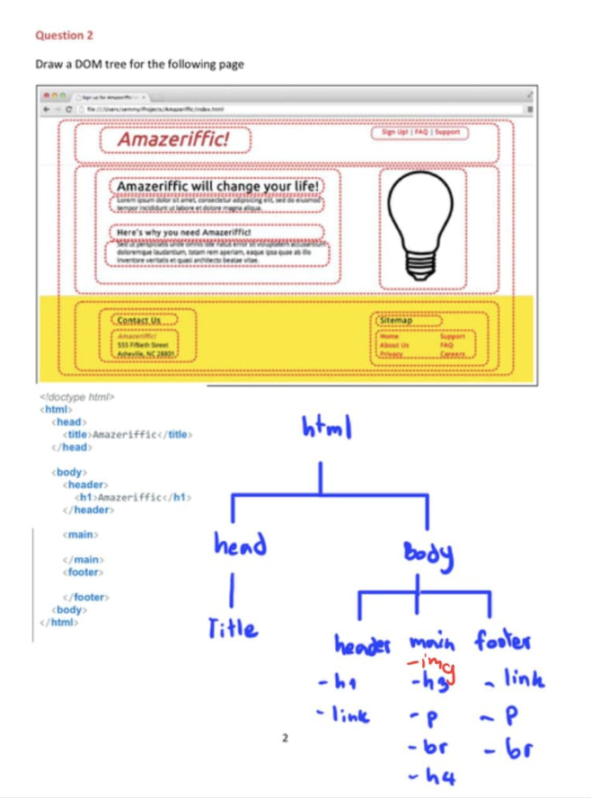
Question 3-4 visit on : https://codepen.io/chayatep01/pen/mGJLQx

